Slide 1
Distributed System Architectures

Slide 2
Centralized Architectures
Client server architecture
Decentralized Architectures
Structured P2P
Unstructured P2P
Hybrid Architectures
Edge server systems
Collaborative Distributed Systems

Slide 3
Hybrid Architectures
Combine Client Server architecture with decentralized architectures
Edge server systems
Collaborative Distributed Systems
Edge server systems
Systems deployed on the Internet where servers are placed at the edge of the network
end users at home connect to the Internet through their ISP
the ISP can be considered as residing at the edge of the Internet.

Slide 4
End users, or clients in general, connect to the Internet by means of an edge server.
The edge server's main purpose is to serve content, possibly after applying filtering and transcoding functions.
More interesting is the fact that a collection of edge servers can be used to optimize content and application distribution.
The basic model is that for a specific organization, one edge server acts as an origin server from which all content originates. That server can use other edge servers for replicating Web pages

Slide 5
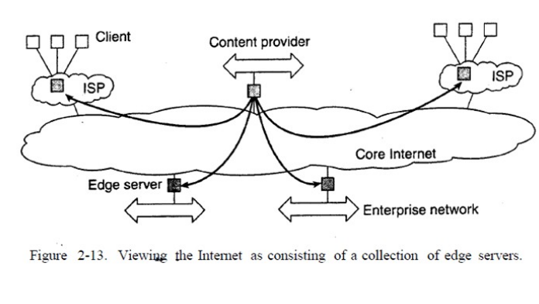

Slide 6
Collaborative Distributed Systems
BitTorrent vs Cient-Server Downloading
In traditional downloading, the server uploads the file, and the client downloads the file.
For popular files, this isn’t very effective.
More people downloading the same file will put the server under strain,so clients can not download the file fast.
Second it’s centralised. Say the system dies, the file no longer exists - no one can download it.
BitTorrent aims to solve these problems.

Slide 7
Hybrid P2P concept.
Unlike other download methods, BitTorrent maximizes transfer speed by gathering pieces of the file you want and downloading these pieces simultaneously from people who already have them.
BitTorrent Architecture
BitTorrent distributes a file by partitioning it into ‘pieces’ and distributing the pieces amongst its peers.
The architecture normally consists of the following entities:
a ‘tracker’
a static metainfo file (a torrent file)
an original downloader (seed)
the end user downloader (leecher)

Slide 8
Tracker
A BitTorrent tracker is server software that centrally coordinates the transfer of files among users, the tracker does not contain a copy of the file and only helps peers discover each other
The tracker and the client exchange information using a simple protocol on top of HTTP.
The clients inform the tracker regarding the file they want to download, their IP and port and the tracker respond with a list of peers downloading the same file and their contact information.
This list of peers that all share the same torrent represents a ‘swarm’.
The tracker is necessary for peers to find each other and transfer data
Because of the presence of this central entity, BitTorrent protocol is considered as a Hybrid P2P implementation.

Slide 9
Metainfo file
The metainfo file is also called as a torrent file and has a .torrent extension.
This file can be shared using the regular methods such as email, file sharing websites etc.
Seeders
The original downloader is a peer with the whole file. Also known as seeder.
The seeder must keep uploading the file until a complete copy has been distributed among the downloaders.
As long as there is a complete copy collectively present among the peers the download will continue for all.

Slide 10
Leechers
The peers without a complete copy of the file are known as leechers.
Leechers will get the list of peers from the tracker which have the pieces that the leecher requires. The leecher then downloads the required piece from one of those peers.
A leecher can also distribute the pieces that it has completed downloading even before it completes downloading the whole file.
Once a Leecher has all the pieces it is called as seeder.
As a leecher receives the ‘pieces’ it validates them against the hashes present in the meta info file.
Any user downloading the file through BitTorrent will be called as a leecher, once they have a full file they can be called as seeders.

Slide 11
Once the nodes have been identified from where chunks can be downloaded,the downloading node effectively becomes active.
At that point, it will be forced to help others, for example by providing chunks of the file it is downloading that others do not yet have
This enforcement comes from a very simple rule: if node P notices that node Q is downloading more than it is uploading, P can decide to decrease the rate at which it sends data to Q

Slide 12
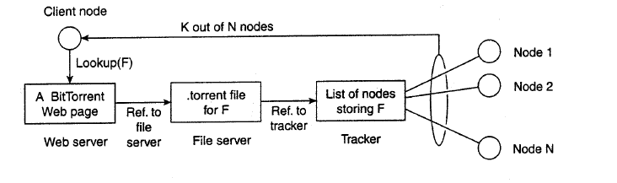

Slide 13
Message Passing

Slide 14
Remote Procedure Call (RPC)
Remote Procedure Call (RPC) is a powerful technique for constructing distributed, client-server based applications.
RPC is a protocol that one program can use to request a service from a program located in another computer
It is based on extending the conventional local procedure calling so that the called procedure need not exist in the same address space as the calling procedure. The two processes may be on the same system, or they may be on different systems with a network connecting them.

Slide 15
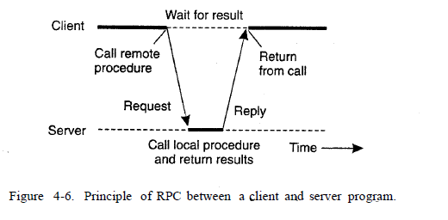

Slide 16
RPC includes
The client
The client stub
The RPC runtime (RPC communication package)
The server stub
The server

Slide 17
The client
It is the user process which initiates a RPC
The client makes a perfectly normal call that invokes a corresponding procedure in the client stub.
The client stub
On receipt of a request it packs a requirement into a message and asks to RPC runtime to send
On receipt of a result it unpacks the result and passes it to client
RPC runtime
It handles transmission of messages between client and server

Slide 18
The server stub
It unpacks a call request and make a perfectly normal call to invoke the appropriate procedure in the server.
On receipt of a result a procedure execution it packs the result and asks to RPC runtime to send
The Server
It executes on appropriate procedure and returns the result from a server stub

Slide 19
